Slide 1
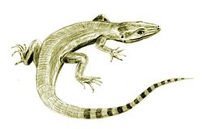
search
Amphibians
Amniote - Class
edit
Earliest Known Member
Scientific Name
Image
Other Names:
Description
Evolutionary new features
Time-
line
Archaeothyris
Map(s)
Mammals
Sauropsida
Synapsida
Mammals
Birds
Crocodiles
Humans
Dinosaurs
Platypus

Slide 2
Notes
There will probably be unnamed clades taken from proposed clade diagrams. We can label them as “subclade” or “unnamed” or something.
The example can be “Earliest Known Member”, “Early Member”, “Basal Member”, “First Looked Like”, “Example Members” (for a composite photo)
The primary name shown in the blue bar will be the Common name. This could be made configurable.
Additional fields that could be included:
  Color(?) indication if this clade is extinct or not

